Slide 1

Private Label Opportunities
Team 1: Patty, Andrea, Patrick, Bryce, Miguel
December 2024
AKA the Best Team

Slide 2

Agenda
Numerator Background & Private Label: | Patty Kingery
The Numerator Data vs US Census Data: | Andrea Ayala
Private Label Shoppers & Products: | Patty Kingery
Kroger Background, Gap Analysis, Opportunity (Example): | Patrick Grodach
Ground Beef Opportunity (Example): | Bryce Williams
Market Basket Analysis (Example): | Andrea Ayala
Recommendation Engine Product: | Miguel Garcia

Slide 3



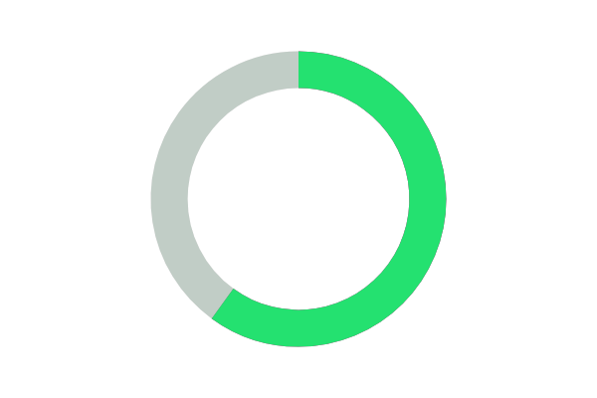
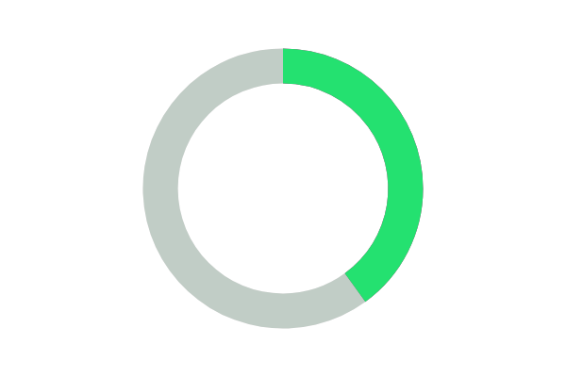





Introducing Numerator
Corporate HQ
Clients
Chicago, IL
1,300
Global Presence
60%
of the Fortune 500
40%
of the
Global 100
U.S., Canada, India, Australia
Employees
Differentiator
2,400
Fastest, broadest set of
omni-channel market data insights for consumer brands and retailers
Backing
Bain Capital (Kantar Portfolio)

Slide 4
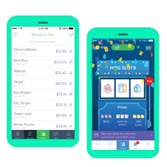
Our modern Consumer Panel has higher engagement and compliance
Gamified consumer app and proprietary passive collection technology create unprecedented participation and scale
AI and optical character recognition
enables scale and accuracy
2 way interaction with panel enables fast surveys of verified buyers
200M+
Annual receipt capture pace
+450,000
Active Panelists (4.5x nearest competitor)
Omnichannel Coverage
Including Amazon
‹#›

Slide 5
Private Labels

Slide 6
Quality and Perception Shift
Benefits for Retailers
Private label brands are products owned and sold by a specific retailer, designed to compete with national brands.
Once seen as lower quality, now offer comparable quality to name brands at lower prices.
Significant sales growth, with private labels outpacing national brands.
Customer-Centricity: Tailored products meet specific demographic needs.
Cost-Effectiveness: Higher profit margins (>10% to 20% higher than National Brands) and appeal to price-sensitive shoppers.
Product Range: Includes various categories such as groceries, household goods, and personal care items.
Operational Advantages
Challenges and Risks
Enhanced control over supply chain and inventory management.
Improved on-time delivery and responsiveness to customer demand.
Exclusivity: Available only at the retailer's stores, creating a unique shopping experience.
High start-up costs for production and potential market acceptance issues.
Importance of analyzing customer preferences to mitigate risk.

Slide 7
Data Demographics

Slide 8

Numerator Data: Gender
The dataset was heavily skewed toward female respondents.
20%
79%
1%
Other
Male
Female

Slide 9
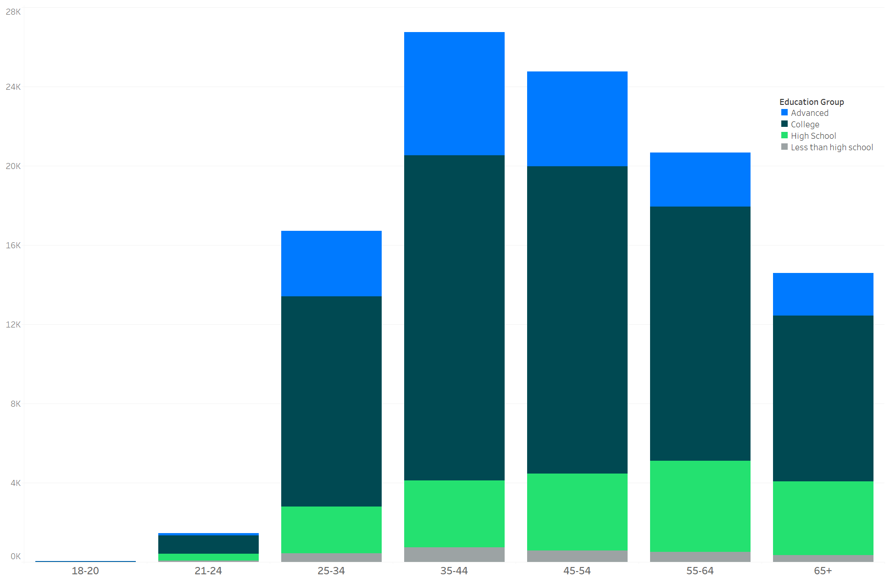
Numerator Data: Age & Education
The age and education distributions are representative of the U.S. population.
Majority of the people have at least a college education.

Slide 10
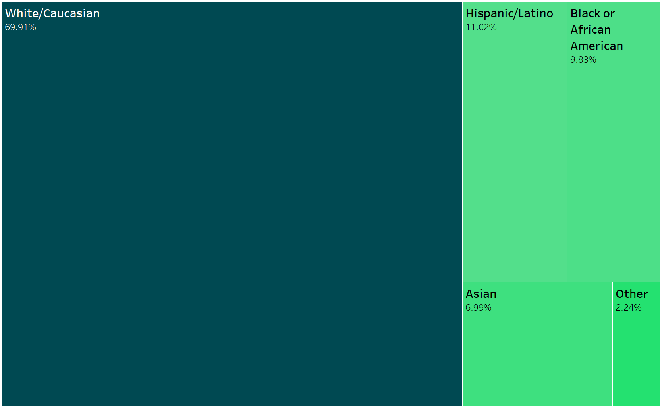
Numerator Data: Ethnicity
There was a significant underrepresentation of individuals categorized as Hispanic/Latino.
While the U.S. Census reported 18.7% of the population as Hispanic/Latino in 2019, the Numerator dataset only reflected 11%.

Slide 11
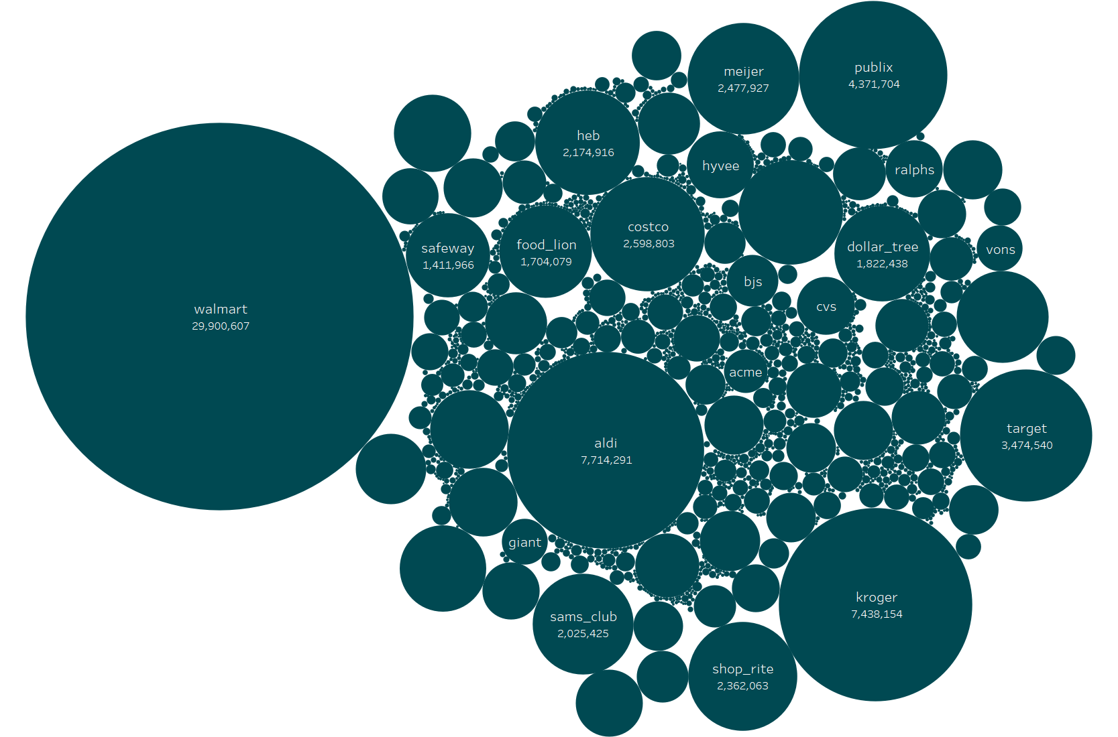
Total Transactions by Retailer
Notes:
Data filtered to only include retailers with over 1k transactions.

Slide 12
Data Preparation: Who are these Private Label Users
Once we confirmed that the data from Numerator by and large was representative of the US Population (except over-representative for females and under-representative for Latinos)
104,910 unique users with 100+ items purchased
% of items purchased PL:
1st Quartile: 14.96%
Mean: 24.21%
3rd Quartile: 30.76%
PL Category:
Low PL: 0 – 21.71%
Med PL: >21.71% to <= 30.76%
High PL: > 30.76%
Income Buckets:
Low Income: <$50,000
Med Income: >= $50,000 to < $90,000
High Med Income: >=$90,000 to < $175,000
High Income: >= $175,000

Slide 13
Data Analysis: Who are these Private Label Users
Ran pairwise Cramer’s V to determine which variables are strongly correlated to ensure we removed chance for collinearity (Has_Children and Is_Latino were removed)
Addressed class imbalance prior to doing the logistic regression by oversampling the Med and High private label data to match the Low private label shoppers
Performed Multinomial Logistic Regression for demographic variables to see which are statistically significant to predict whether someone is high, medium or low private label purchasers
Statistically Significant Independent Variables:
Marital Status
Ethnicity
Region
Education Group
Employment
Income Group

Slide 14
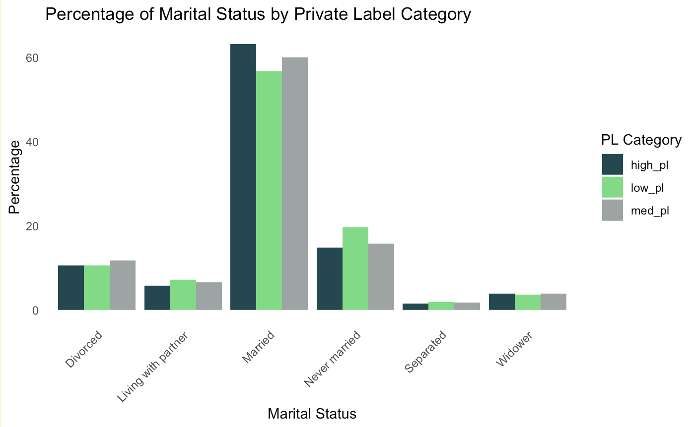
Marital Status: By Private Label Category
High private label
Low private label
Medium private label

Slide 15
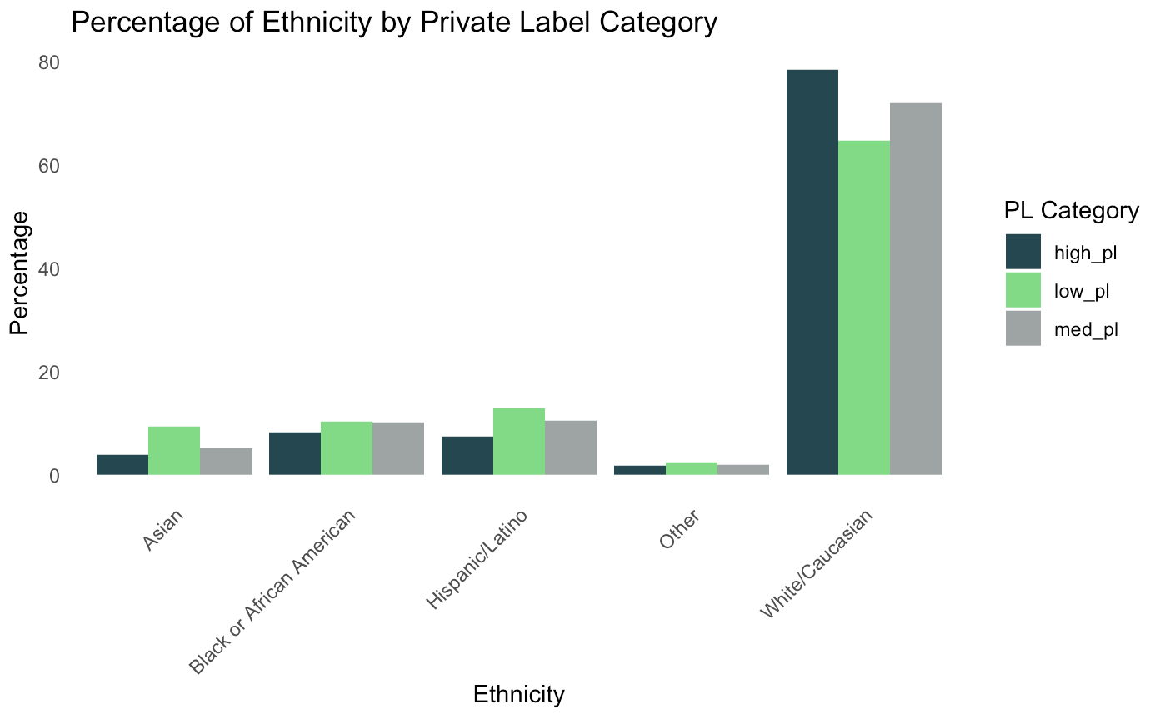
Ethnicity: By Private Label Category
High private label
Low private label
Medium private label

Slide 16
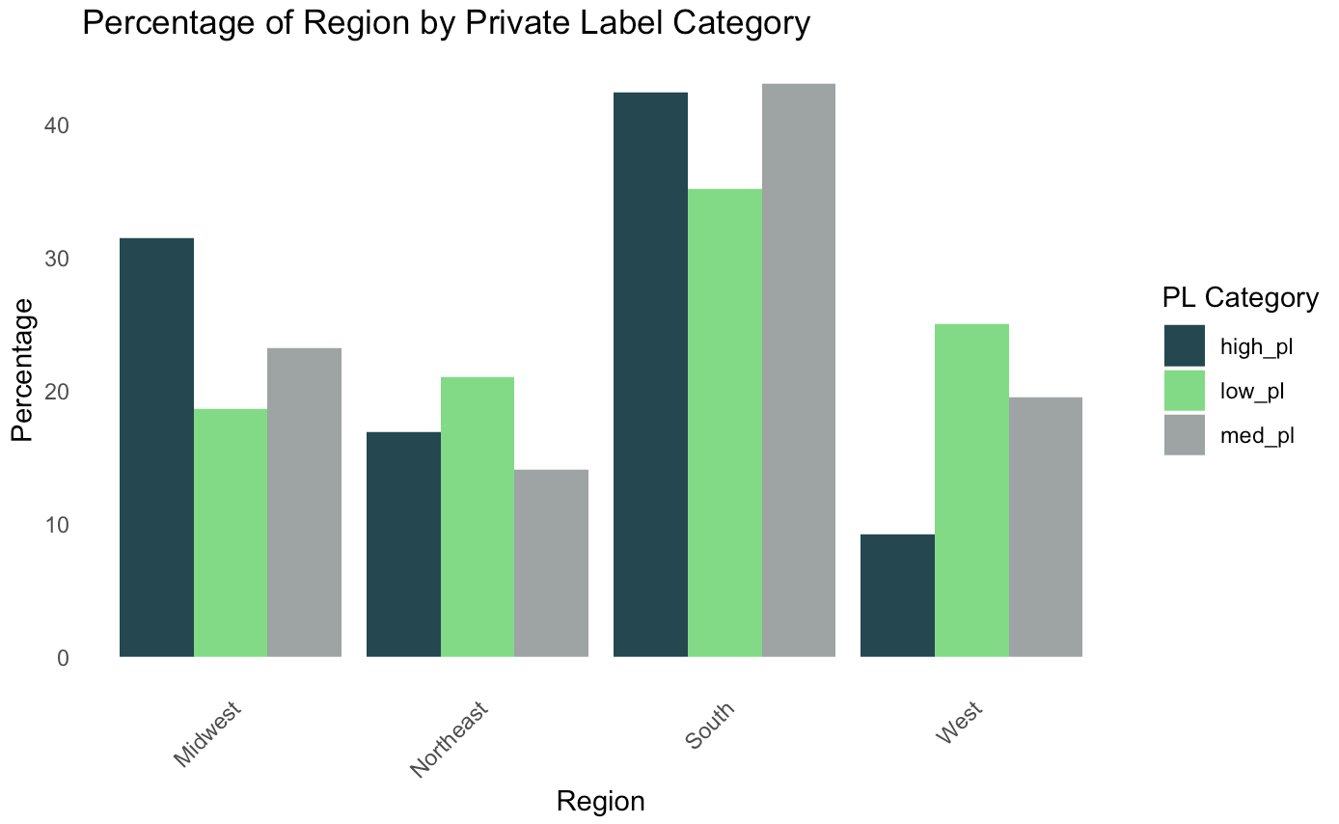
Region: By Private Label Category
High private label
Low private label
Medium private label

Slide 17
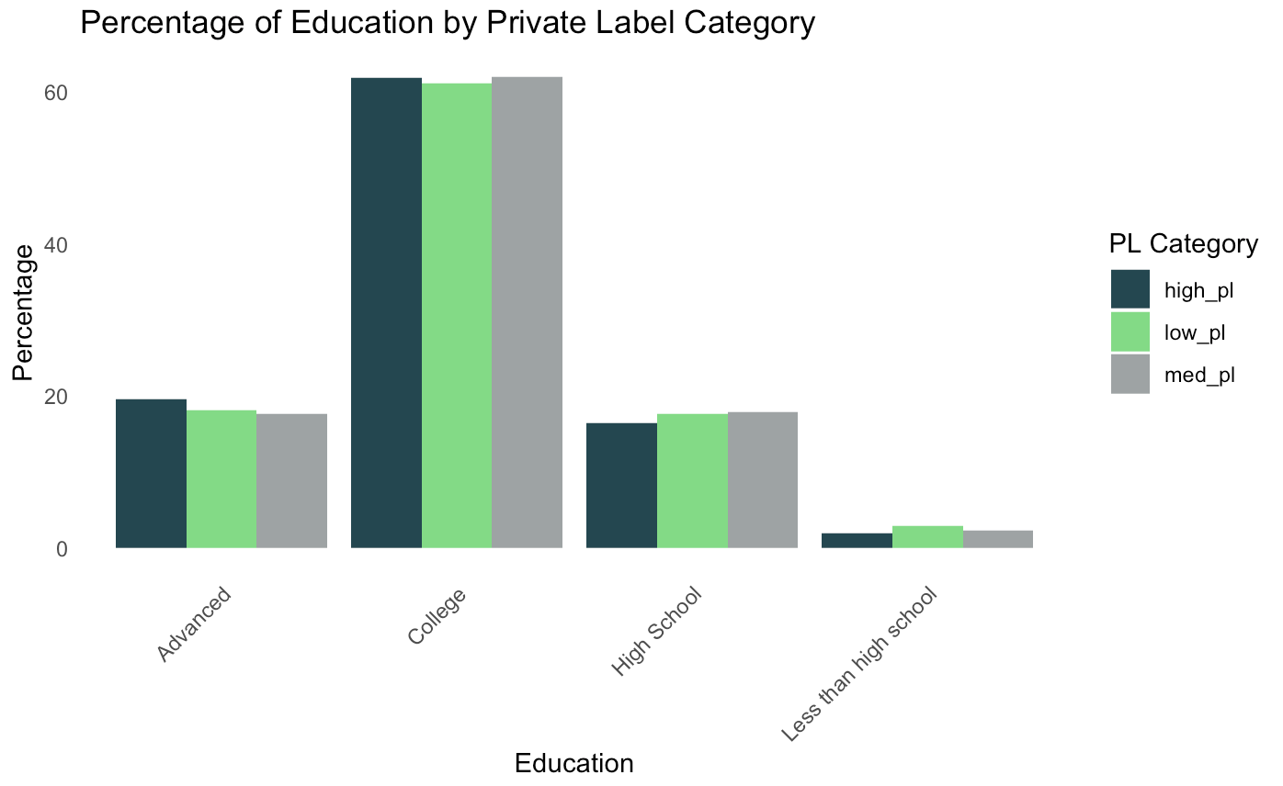
Education: By Private Label Category
High private label
Low private label
Medium private label

Slide 18
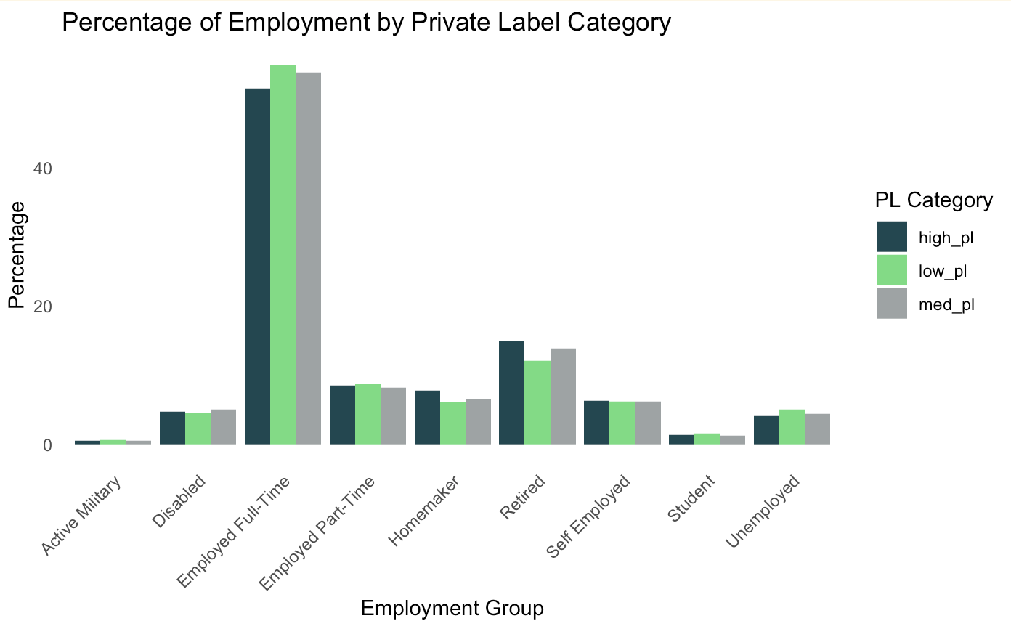
Employment: By Private Label Category
High private label
Low private label
Medium private label

Slide 19
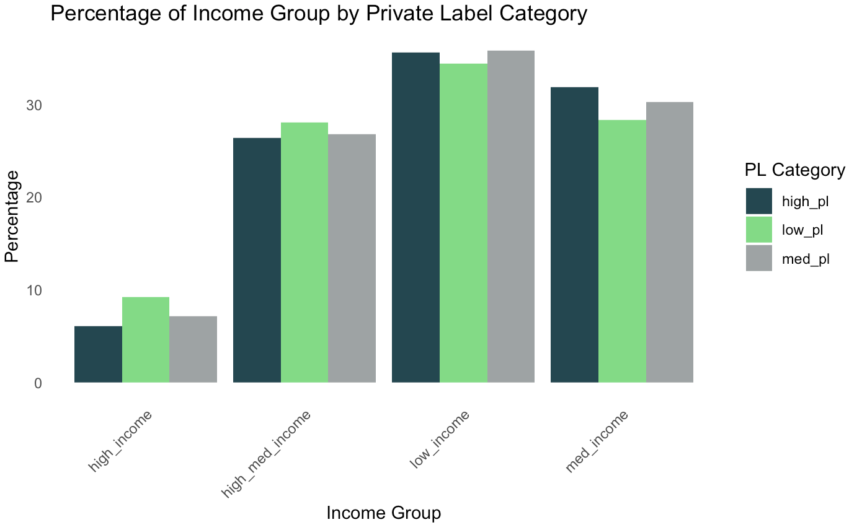
Income Group: By Private Label Category
High private label
Low private label
Medium private label

Slide 20
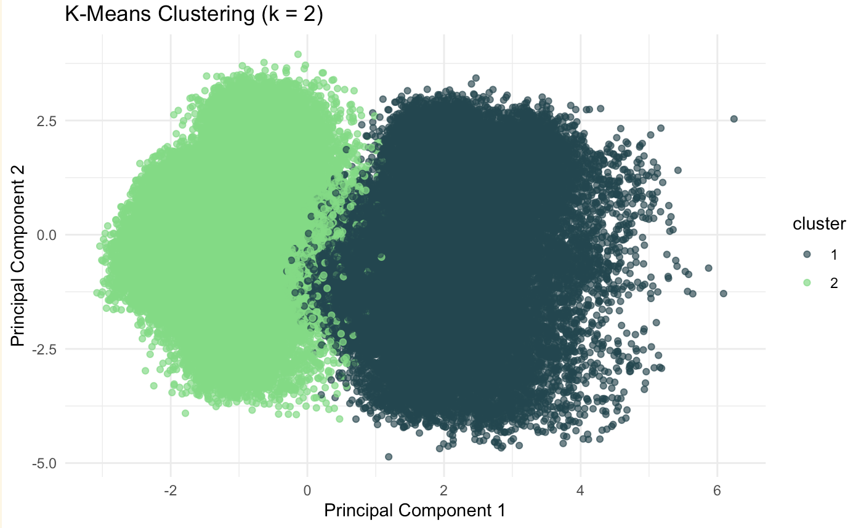
Cluster For All Customers
Cluster 1: Generation Luxe
Cluster 2: Next-Gen Familia
Demographic Insights:
Stable (married), wealthier and better-employed
Fewer Latino but more diverse overall.
Smaller Households
Marketing Strategies:
Promote premium or value-added products that appeal to older, wealthier, and diverse households.
Leverage messages around quality and convenience, as these resonate with smaller, affluent households.
Demographic Insights:
Represents younger, family-oriented households.
Represents middle-income families.
Has a stronger Latino presence
Marketing Strategies:
Focus marketing efforts on family-oriented products, bulk purchases, and items for children.
Highlight culturally tailored campaigns for Latino audiences.
Cluster 1: 62,502 users
Cluster 2: 42,408 users

Slide 21
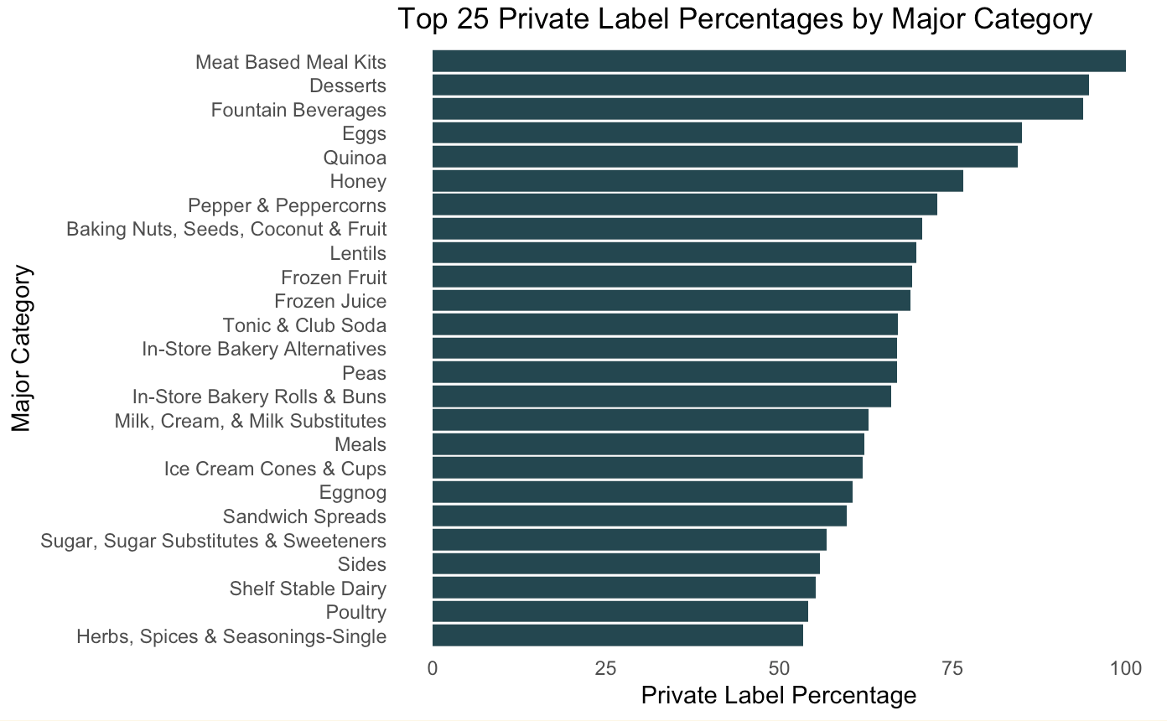
What is Being Purchased in Private Label

Slide 22
Kroger

Slide 23
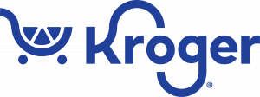

Kroger: Background
The nation’s largest grocer with nearly 2,800 stores in 35 states operating under 28 different names.
Innovation
The largest food manufacturing business in America.
About 40% of private-label items are made at one of Kroger’s manufacturing plants.
This accounts for 26% of Kroger’s total store dollar sales, giving Kroger a significant strategic advantage.
Our Data
7,438,154 transactions
$28,420,234 in sales

Slide 24
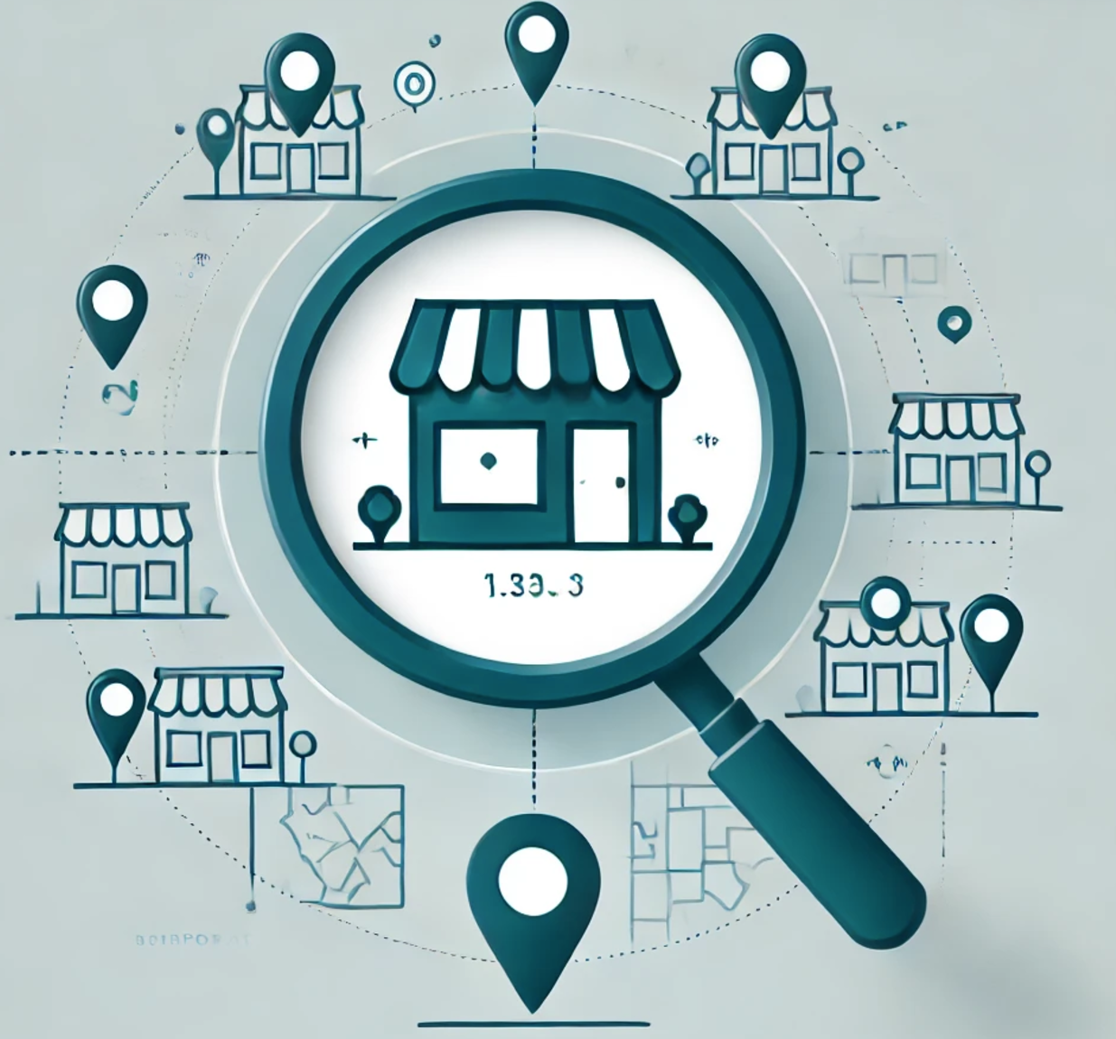
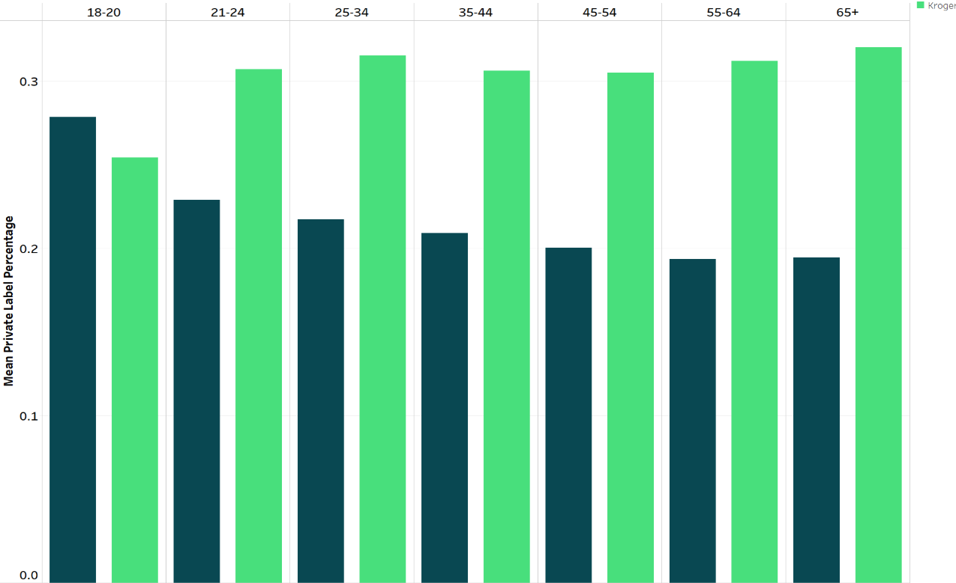
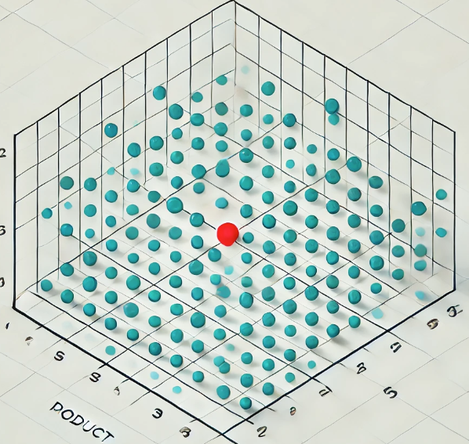

Identify Relevant Benchmark Stores
“Gap Analysis” Against Benchmarks
Focus on Specific Product Opportunities
Time Series & Market Basket Analysis for Deeper Insight

Slide 25
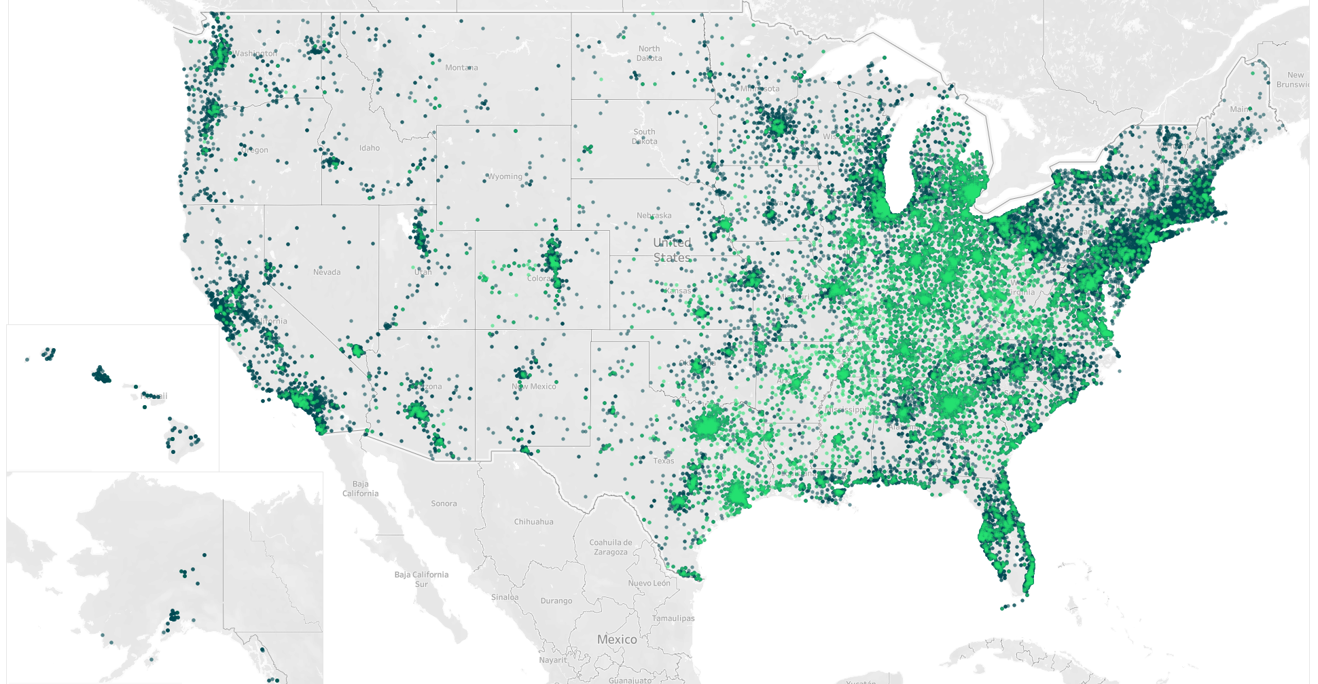
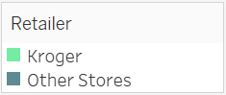
Benchmark Stores
Benchmark Stores: Costco, Amazon, Meijer, Giant Eagle, Publix, Whole Foods

Slide 26
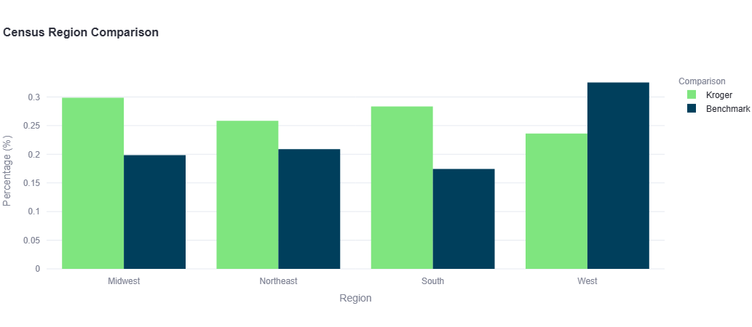
Kroger vs Benchmark: Census Region

Slide 27
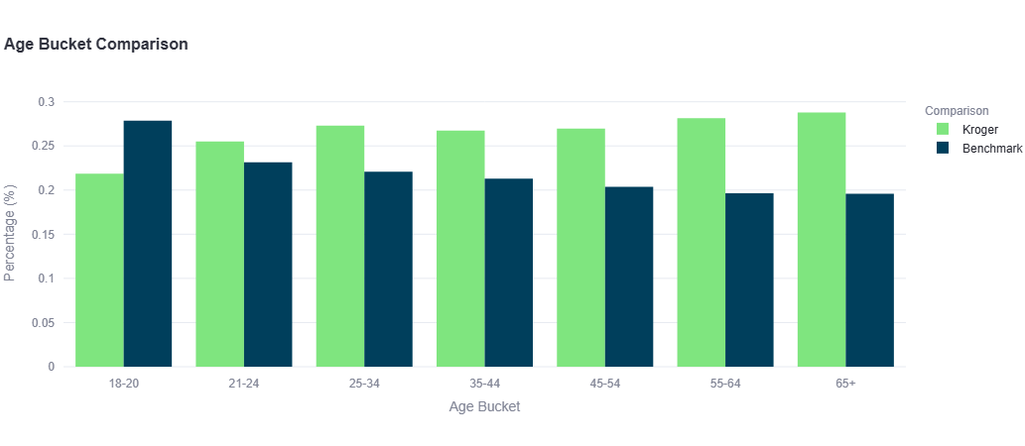
Kroger vs Benchmark: Age Bucket

Slide 28
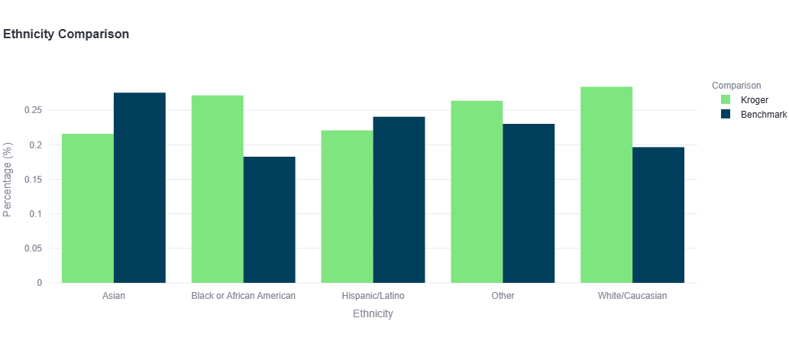
Kroger vs Benchmark: Ethnicity

Slide 29
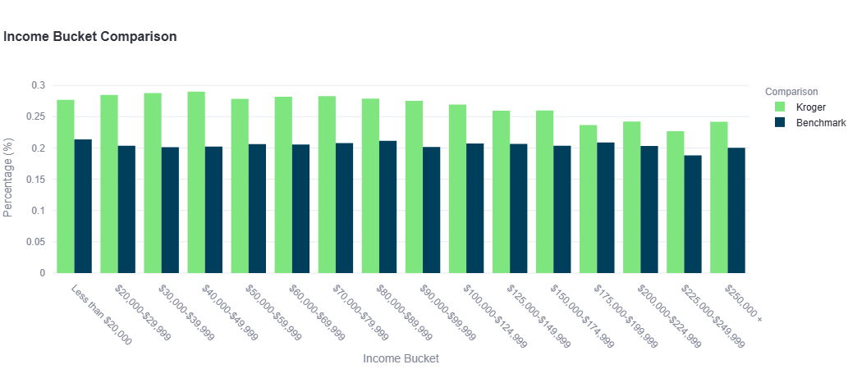
Kroger vs Benchmark: Income Bucket

Slide 30
Kroger Opportunities: West Region
Top 3 Opportunities | Store Private Label | Benchmark Private Label
Still Water | 45.21% | 60.82%
Steak | 5.82% | 17.43%
Pork Bacon | 43.41% | 52.01%
Benchmark Stores: Costco, Amazon, Meijer, Giant Eagle, Publix, Whole Foods

Slide 31
Kroger Opportunities: Asians
Top 3 Opportunities | Store Private Label | Benchmark Private Label
Still Water | 41.81% | 62.25%
Steak | 6.28% | 26.26%
Pork Bacon | 40.72% | 50.50%

Slide 32
Kroger - Ground Beef Forecast

Slide 33
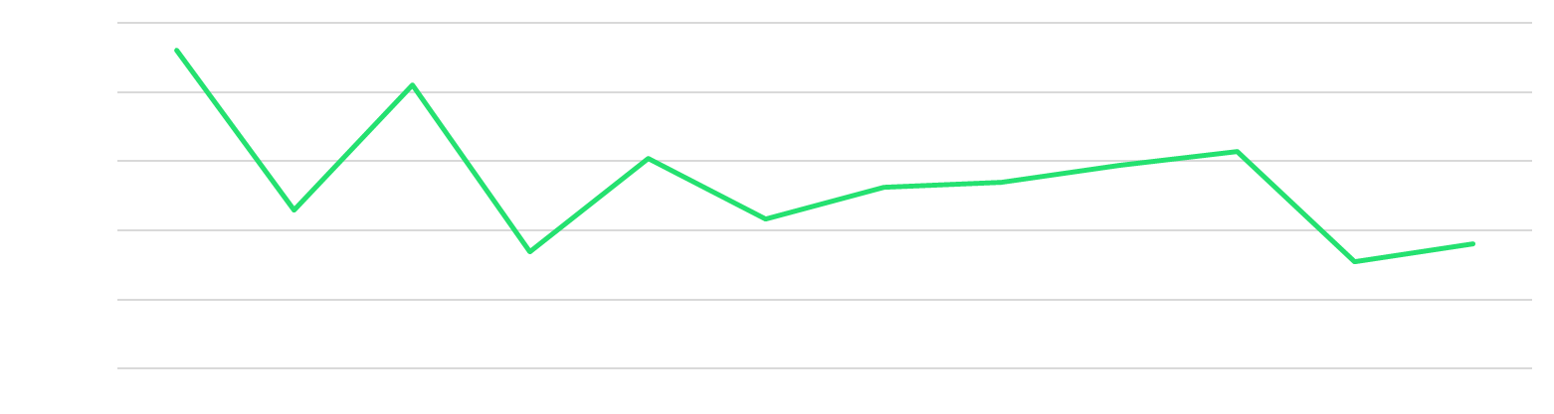
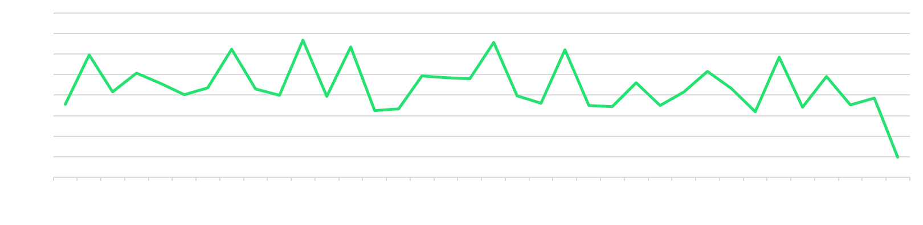
West Coast Ground Beef Sales - Numerator
Ground Beef Sales by Pounds - USDA Food and Safety and Inspection Services

Slide 34
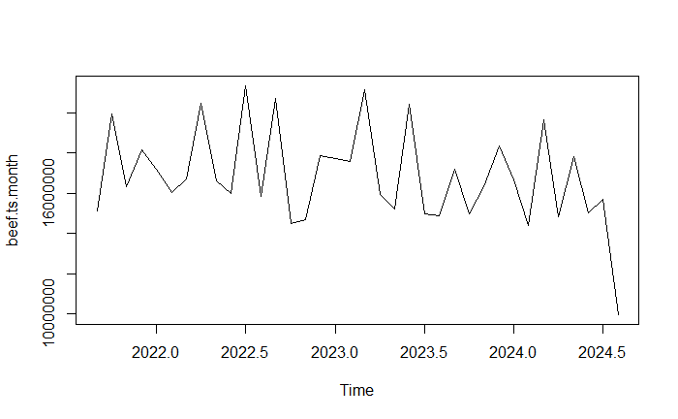
Time Series Analysis
USDA Data used for time series analysis.
Training data ranges from 9/2021 to 2/2024.
Validation data ranges from 3/2024 to 8/2024
Pounds of Ground Beef Sold
2021
2022
2023

Slide 35
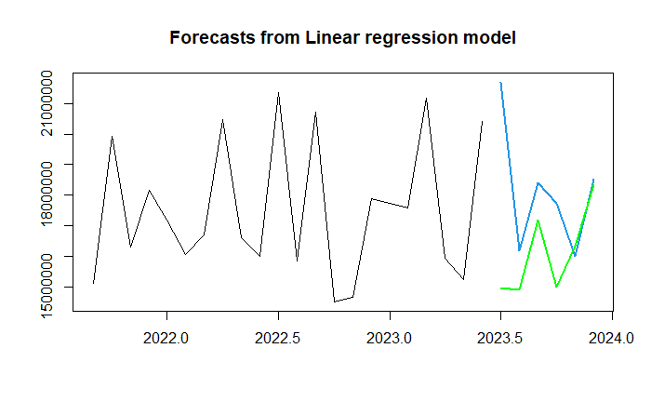
Time Series Model Testing
Model | RMSE | MAE | MAPE
Linear Regression Model | 1,695,162 | 1,352,476 | 7.79
Naive Method | 3,571,338 | 2,975,448 | 16.87
Linear Regression Model
Regression Polynomial Trend
Holt-Winter Method
Arima
Naive Method
ETS Model
Pounds of Ground Beef Sold
Blue Line: Linear Regression Model
Green Line: Validation Data
Black Line: Training Data
2022
2023
2024

Slide 36
Kroger Opportunity - Ground Beef
All Ground Beef Sales in US West Region
All Private Label Ground Beef Sales in US West Region
Store | Items Sold | Percentage | Rank
Kroger | 28,126 | 20.8% | 1
Walmart | 27,991 | 20.7% | 2
Albertsons | 22,246 | 16.4% | 3
Costco | 8,664 | 6.4% | 4
Winco Foods | 8,335 | 6.2% | 5
Store | Items Sold | Percentage | Rank
Walmart | 27,691 | 43.2% | 1
Kroger | 18,071 | 28.2% | 2
Costco | 8,654 | 13.5% | 3
Sam’s Club | 2,772 | 4.3% | 4
Trader Joe's | 1,972 | 3.1% | 5
Total Items Sold: 135,442
Total Items Sold: 64,053
West Coast Ground Beef
Private Label Market: 47.29%

Slide 37
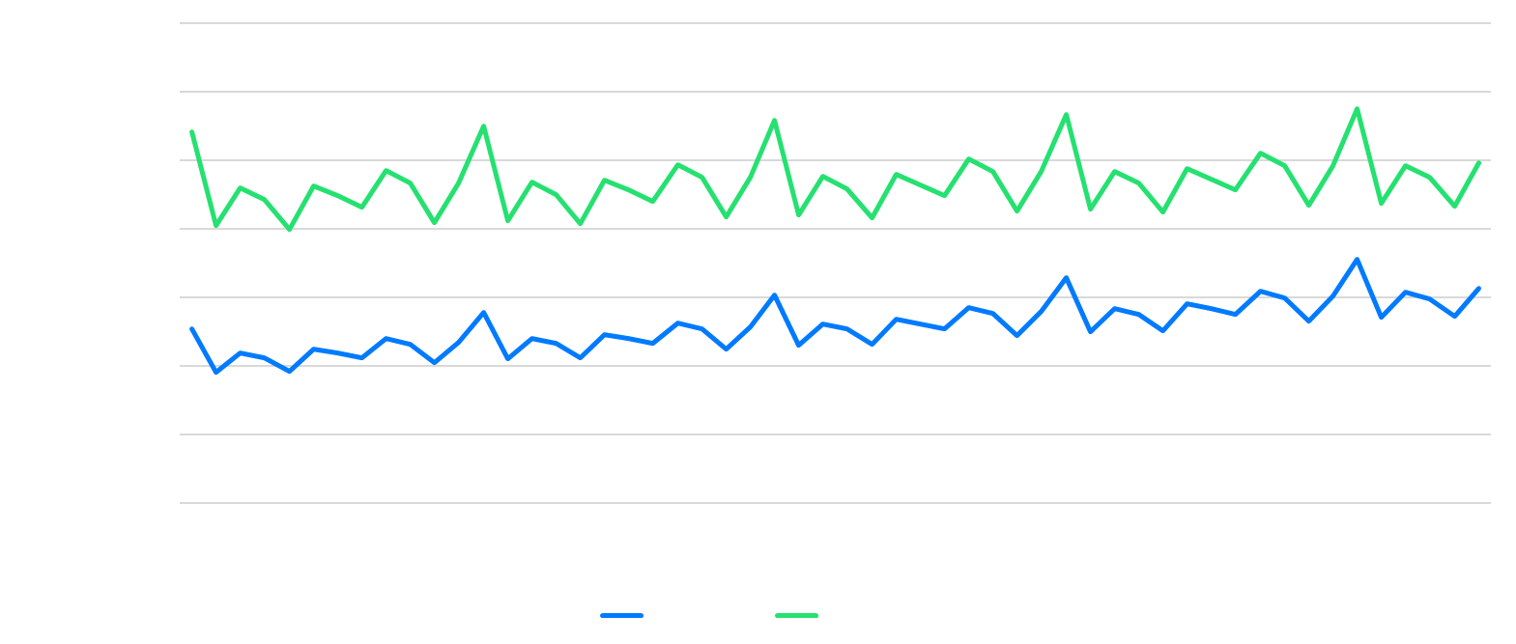
Kroger Opportunity - Numerator Data
Assumptions
Private Label market share will increase 3.7% YOY (Source: Karry Group)
Average price for ground beef on in West Region is $4.99/pound (Source: Bureau of Labor Statistics)

Slide 38
New Revenue Opportunity
 | 2025 | 2026 | 2027
Total Sales Private Label Forecast | $ 646,689,849 | $ 700,192,559 | $ 755,169,793
Kroger's Profit at 28.2% Market Share (Current) | $ 63,828,288 | $ 69,109,006 | $ 74,535,259
Kroger's Profit at 43.9% Market Share | $ 77,851,927 | $ 85,687,579 | $ 93,749,791

Slide 39

Kroger: Market Basket Analysis
Now let’s look at private label opportunities for Kroger…
Comparison between benchmark items and Kroger basket items.
Analyzes customer purchasing patterns to help businesses understand and serve their customers better.
Outcome of an MBA: Association Rules
A set of rules that describe the patterns that exist between itemsets in the market basket data.
Association Rules can answer questions like…
What products should be displayed together in the store?
What products could be discounted together in order to increase sales?
What products should be recommended to customers as part of a cross-selling strategy?

Slide 40





How is it measured?
Association Rule
Antecedent (LHS)
Consequent (RHS)

Slide 41
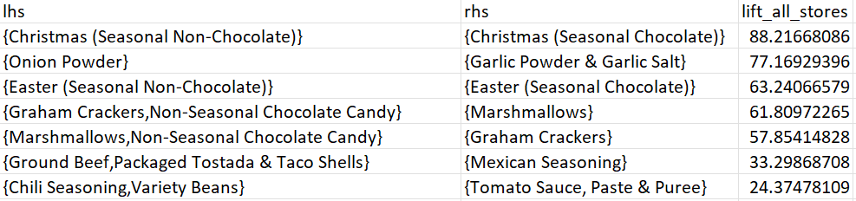
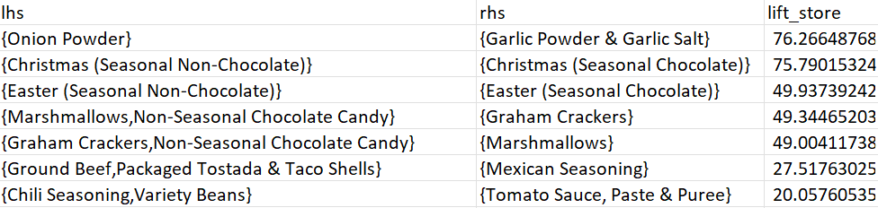

Market Basket Analysis
Benchmark Data (Top 8 by Lift)
Kroger Data (Top 8 by Lift)
Notes:
Still Water, Ground Beef, Pork Bacon, Chicken-Prepared, Steak

Slide 42
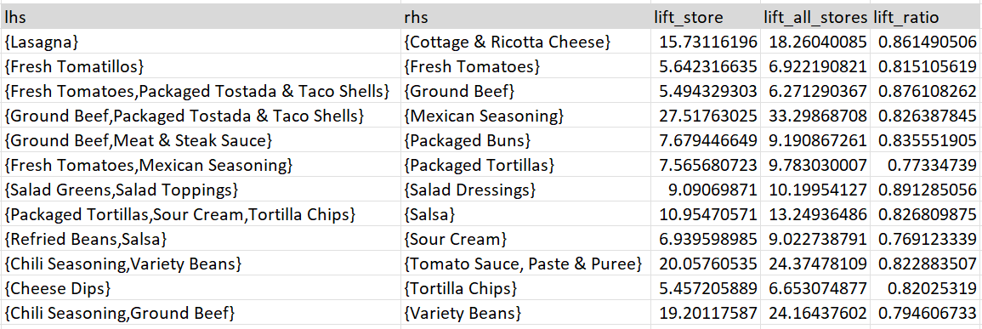
Comparative MBA: Kroger vs. Benchmark
Product Opportunities
Ground Beef
Pork Bacon
Chicken
Steak
Still Water
"Lift ratio"
Represents the comparison between the selected store's lift for certain product pairings and the lift observed across all stores.
< 1 indicates areas where the selected store is trailing
Such pairings can be viewed as opportunities to strengthen product associations and improve cross-selling strategies within the store.
> 1 indicates the store is outperforming the broader market in promoting certain combinations, indicating strong in-store associations for those products.

Slide 43
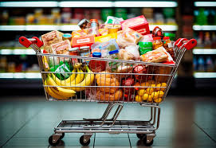
Recommendations Based on MBA
Reposition Key Products: Move complementary items (e.g., sour cream, Mexican seasoning, and fresh tomatoes) closer together to encourage cross-selling. Create Bundled Promotions: Offer discounts on product pairings. Leverage Personalized Deals: Use customer data for targeted promotions and personalized product suggestions, both in-store and through digital channels.
Notes:
Still Water, Ground Beef, Pork Bacon, Chicken-Prepared, Steak

Slide 44
Numerator Product

Slide 45
Unveiling Opportunities for Private Label Success
Empowering Retailers with Data-Driven Insights
Provide actionable insights on private label opportunities at Kroger using Numerator data.
Overview:
Interactive Dashboard that helps executives analyze market penetration of private label products and identify key opportunities to drive growth.
Key Features:
KPIs:
Total Sales, Private Label Sales, Penetration Rate, and Benchmark Comparison Gap.
Top Performing Categories:
Highlight Kroger's top 5 private label product categories.
Performance Charts:
Compare Kroger's performance against benchmarks across

Slide 46
Strategic Value
Opportunity Identification:
Pinpoints top-performing regions, income groups, and demographics for private label growth.
Displays region-specific opportunities with data-driven comparisons to benchmarks.
Data-Driven Decisions:
Empowers teams with insights into where Kroger is underperforming or excelling.
Supports strategic conversations with clients about private label market penetration.
Custom Analysis:
Filter options allow tailored analysis to align with specific client business goals.
Actionable Insights:
Understand demographic trends to influence retail strategies and improve private label adoption rates.

Slide 47


Slide 48
Unlocking Future Potential and Efficiency with Data-Driven Solutions
Key Highlights:
Future Opportunities:
Implement time series models to forecast trends and predict private label growth.
Explore demand patterns across seasons, regions, and demographics to optimize product placement and marketing strategies.
Expand benchmarking capabilities to include global private label market insights.
Benefits of the Decision Engine:
Ease of Use: No need for advanced knowledge of machine learning or time series models – actionable insights are just a click away.
Efficiency: Reduces time spent on manual analysis, enabling faster decision-making.
Scalability: Adaptable to various retailers, allowing for broader private label growth strategies.
Collaboration: Facilitates data-driven discussions among decision makers and teams for unified strategy implementation.
Customization: Flexible filtering options cater to specific business goals, aligning with unique client objectives.
Strategic Value:
Supports a culture of data literacy by simplifying complex analyses into accessible visuals.
Encourages proactive strategy development rather than reactive decision-making.

Slide 49
Questions!

